Slide 1
TBL = To be learned
in session 2 these are the learned songs
UL = unlearned

Slide 2
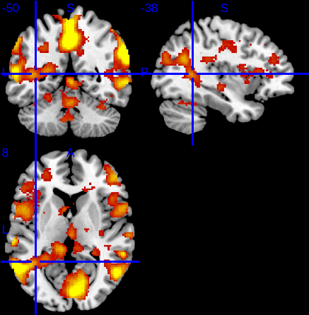
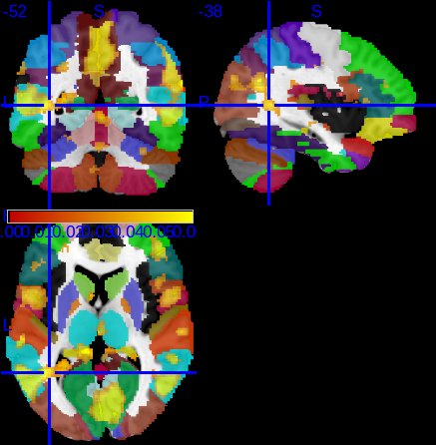
Familiarity as a covariate
With and without anatomy overlay
Left middle temporal gyrus?

Slide 3
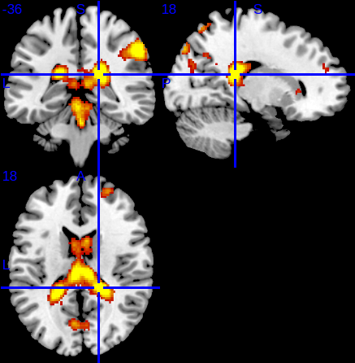
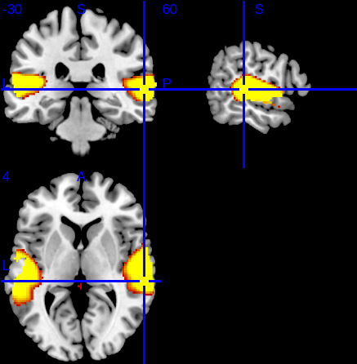
Session 2 – Session 1
No sig clusters
(S2TBL-S2UL)-(S1TBL-S1UL)
No sig clusters
(S2TBLLyr-S2TBLNo)-(S2ULLyr-S2ULNo)-(S1TBLLyr-S1TBLNo)-(S1ULLyr-S1ULNo)
Sig cluster (p FWE corr) @ 18,-36,18
Which looks like ventricle?
Separately, each of these contrasts has activation that looks like this:
(S2TBLLyr-S2TBLNo)
(S2ULLyr-S2ULNo)
(S1TBLLyr-S1TBLNo)
(S1ULLyr-S1ULNo)
The expected language areas in all lyric vs no lyric contrasts
All have bilateral sig clusters (p FWE corr)

Slide 4
All combinations within the larger interaction
(S2TBLLyr-S2TBLNo)-(S2ULLyr-S2ULNo)-(S1TBLLyr-S1TBLNo)-(S1ULLyr-S1ULNo)
(S2TBLLyr-S2TBLNo) - (S2ULLyr-S2ULNo)
(S2TBLLyr-S2TBLNo) - (S1TBLLyr-S1TBLNo)
(S2TBLLyr-S2TBLNo) - (S1ULLyr-S1ULNo)
(S2ULLyr-S2ULNo) - (S1TBLLyr-S1TBLNo)
(S2ULLyr-S2ULNo) - (S1ULLyr-S1ULNo)
(S1TBLLyr-S1TBLNo) - (S1ULLyr-S1ULNo)
No sig clusters
Other contrasts:
S2TBL-S1TBL - No sig clusters
S2TBL-S2UL - No sig clusters

Slide 5
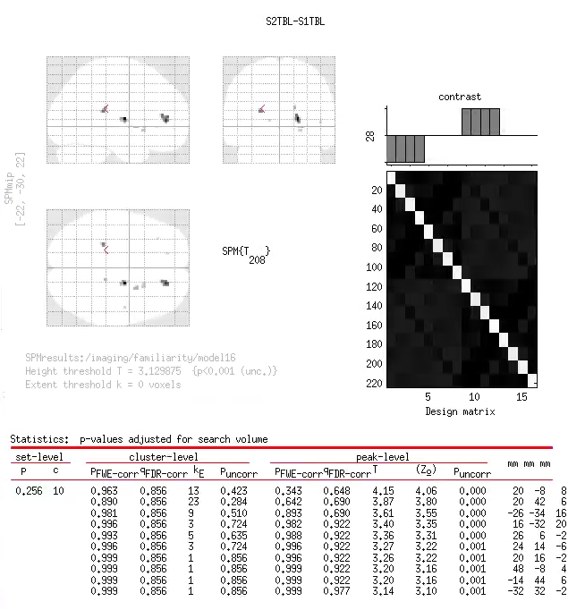

Slide 6
